Slide 1
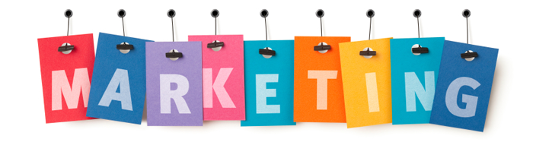
Marketing means identifying the customer need and them designing, packaging, pricing, promoting and distributing a product (or service) in such a way that customers will want to buy.
What is marketing?
List as many key words associated with marketing as you can…

Slide 2
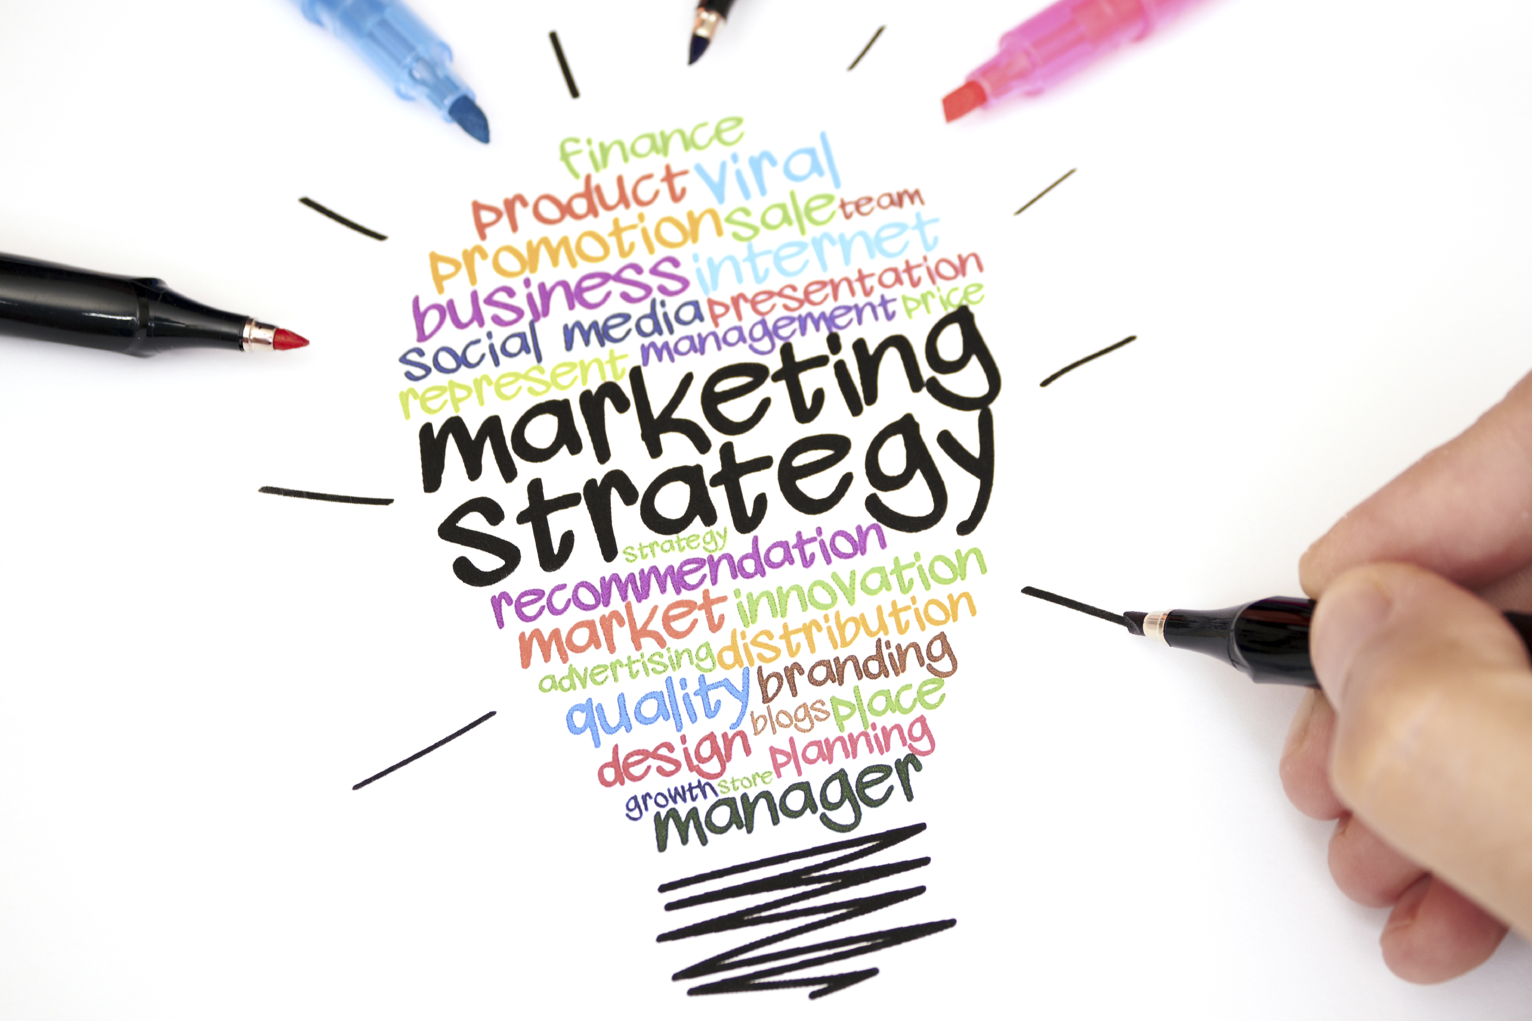
What is a marketing strategy?
A marketing strategy is a plan setting out how business will identify and satisfy the customer needs identified by market research. It does this by…
Researching the market to identify opportunities.
Positioning the product in the market.
Devising a suitable marketing mix.
Segmenting the market to identify target customers.

Slide 3
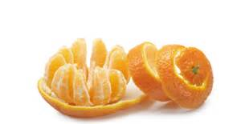
Market segmentation divides consumers into different categories, e.g. you females, high income makes, sports enthusiasts, etc.
The two most common methods of segmenting the market are:
Demographic segmentation analyses consumers in terms of age, income, sex, social class, geographic area, etc.
Psychological segmentation analyses consumers on the basis of their attitudes and tastes, for example, yuppies, hippies, conservatives or impulse buyers.
Researching the market to identify opportunities.
Positioning the product in the market.
Devising a suitable marketing mix.
Segmenting the market to identify target customers.

Slide 4
A marketing strategy is a plan setting out how business will identify and satisfy the customer needs identified by market research. It does this by…
Market segmentation divides consumers into different categories, e.g. you females, high income makes, sports enthusiasts, etc.
The two most common methods of segmenting the market are:
Demographic segmentation analyses consumers in terms of age, income, sex, social class, geographic area, etc.
Psychological segmentation analyses consumers on the basis of their attitudes and tastes, for example, yuppies, hippies, conservatives or impulse buyers.
Researching the market to identify opportunities.
Positioning the product in the market.
Devising a suitable marketing mix.
Segmenting the market to identify target customers.
Product Positioning means creating an image for a product in the mind of the consumers in the target market.
A market niche is a specific gap in the market for a new product or service.
Once a niche has been identified, the customers who will buy such a product will become the target market.
The target market is a precise description of the customers whom a product will be aimed. Normally, this will only be decided after careful market research.

Slide 5
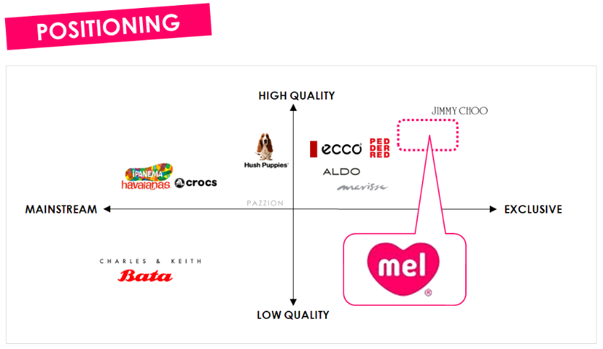
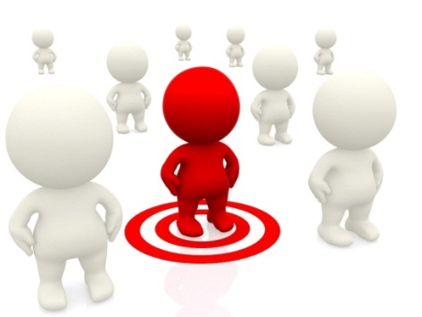
Product Positioning means creating an image for a product in the mind of the consumers in the target market.
Researching the market to identify opportunities.
Positioning the product in the market.
Devising a suitable marketing mix.
Segmenting the market to identify target customers.
A market niche is a specific gap in the market for a new product or service.
Once a niche has been identified, the customers who will buy such a product will become the target market.
The target market is a precise description of the customers whom a product will be aimed. Normally, this will only be decided after careful market research.

Slide 6
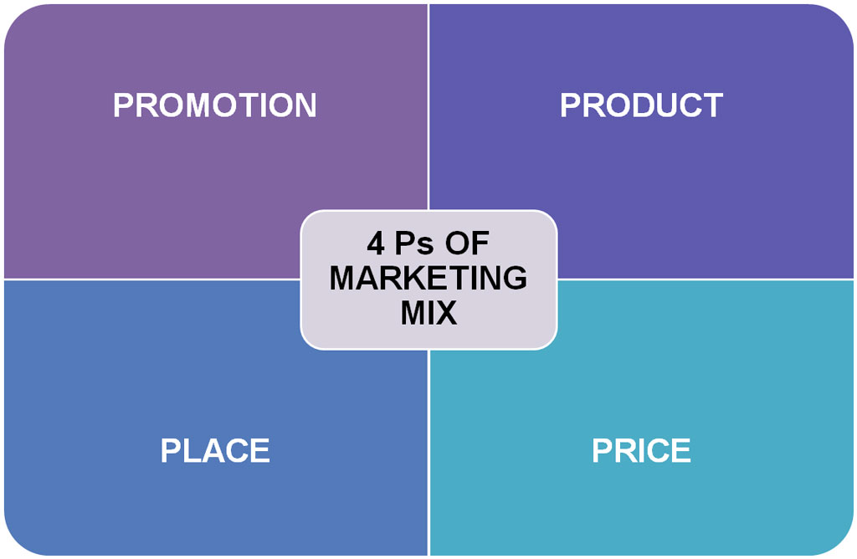

Slide 7
‘Product’ is a good or service produced to meet a customer need. Designing a suitable product is the most important part of the marketing mix. If the product does not satisfy customer needs then the other P’s will not work. The product portfolio/range describes the range of products produced by a business.
DESIGN & QUALITY
The product design and quality must consider:
PRODUCT LIFE CYCLE
BRANDING
PACKAGING
Function: The product must do what consumers expect it to do. According to law, this means that the product must be of merchantable quality & fit for purpose intended.
Form: The product must also be practical & appealing to the target market in terms of shape, style, colour & image.
Branding means creating an identity for a product that clearly distinguishes it from competitors. It consists of a brand name and logo.
A brand name is a distinctive name given to a product, such as as Pepsi Max.
A brand logo is a distinctive visual image that will help the product stand out from competitors. It can be the way a brand name is written, a separate image or both.
A brand leader is the brand with the highest percentage share of the market.

Slide 8
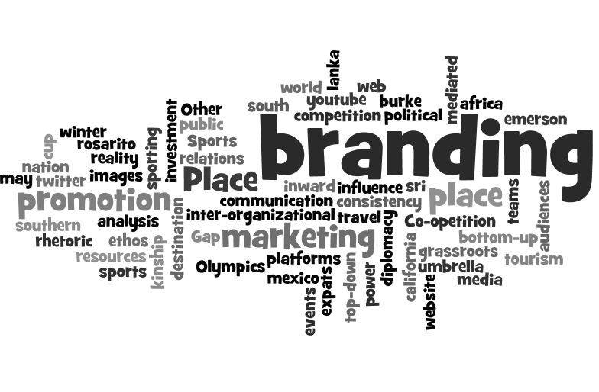
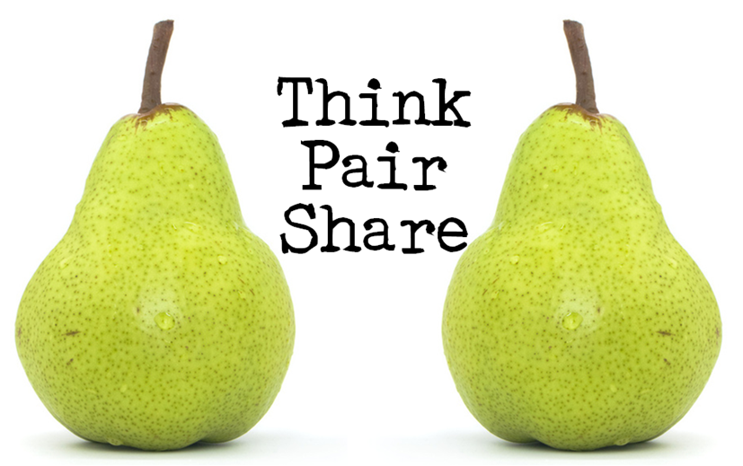
What are the benefits of product branding to a firm?

Slide 9
‘Product’ is a good or service produced to meet a customer need. Designing a suitable product is the most important part of the marketing mix. If the product does not satisfy customer needs then the other P’s will not work. The product portfolio/range describes the range of products produced by a business.
DESIGN & QUALITY
The product design and quality must consider:
PRODUCT LIFE CYCLE
The product life cycle refers to the theory that most products pass through distinct life stages: product development, launch, growth, maturity, saturation and eventual decline
BRANDING
PACKAGING
Function: The product must do what consumers expect it to do. According to law, this means that the product must be of merchantable quality & fit for purpose intended.
Form: The product must also be practical & appealing to the target market in terms of shape, style, colour & image.
Branding means creating an identity for a product that clearly distinguishes it from competitors. It consists of a brand name and logo.
A brand name is a distinctive name given to a product, such as as Pepsi Max.
A brand logo is a distinctive visual image that will help the product stand out from competitors. It can be the way a brand name is written, a separate mage or both.
A brand leader is the brand with the highest percentage share of the market.
Product packaging should provide the following:
Provide protection
Look good
Provide information
How do you protect product branding & packaging?

Slide 10
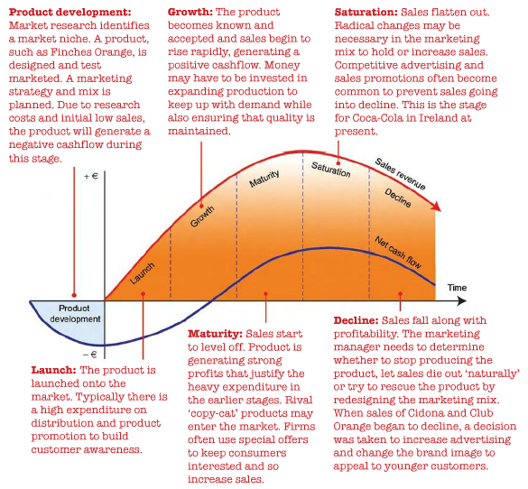

Slide 11
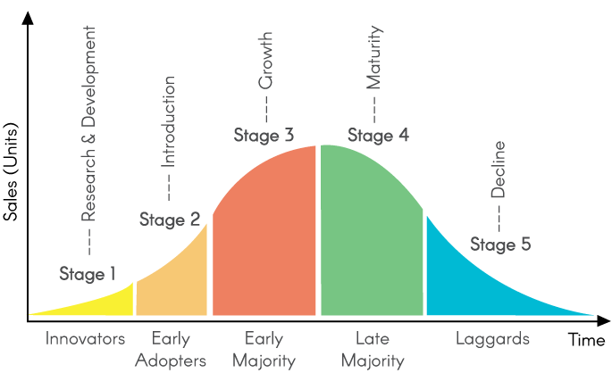
What are the factors that influence the length of a product life cycle?

Slide 12
‘Price’ must be set at a level that will allow the business to earn a profit. The price set will also influence the level of sales and may affect the image and positioning f the product in the eyes of the target market.
General pricing strategies:
1. Mark-up (cost plus pricing) means adding a standard profit percentage to the direct costs of production (cost of sales) of the item to arrive at the final selling price.
2. Psychological pricing means setting a price based on the expectations of the customers in the target market.
High price strategies:
1. Price leadership/premium pricing occurs when a firm deliberately charges a higher price than competitors to create an impression of superior quality.
2. Price skimming is where firms charge a very high price at the launch of a product with the intention of recovering high development costs as quickly as possible.
3. Profit-maximizing pricing means setting a price that will generate the largest amount of profit as quickly as possible.
Low price strategies:
1. Penetration pricing (also known as below-cost selling) is when a low price is charged in order to capture as much market share as quickly as possible.
2. Discriminatory pricing means charging different prices to different customers for the same product or service.
3. Predatory pricing means setting prices below cost in order to drive a competitor out of the market. A price war occurs when competing firms retaliate against price cuts with further reductions.
4. A loss leader is a product sold at or below cost price in the hope of generating other, more profitable sales.
Pricing Strategies aim to set a price that will help the firm to achieve its long term marketing objectives. Whatever the price it must earn sufficient sales to earn a profit from the business.

Slide 13
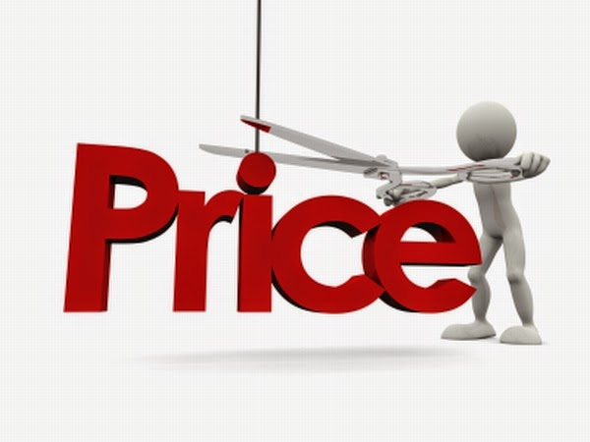
Costs of production and the need to make a profit
Level of demand
Competitors prices and the desired product positioning
Type of product is important as it may require special packaging
What are the factors that influence price?
Legal restrictions on freedom to set prices for certain products or services
Stage in the product life cycle and customer expectations
Government taxes

Slide 14
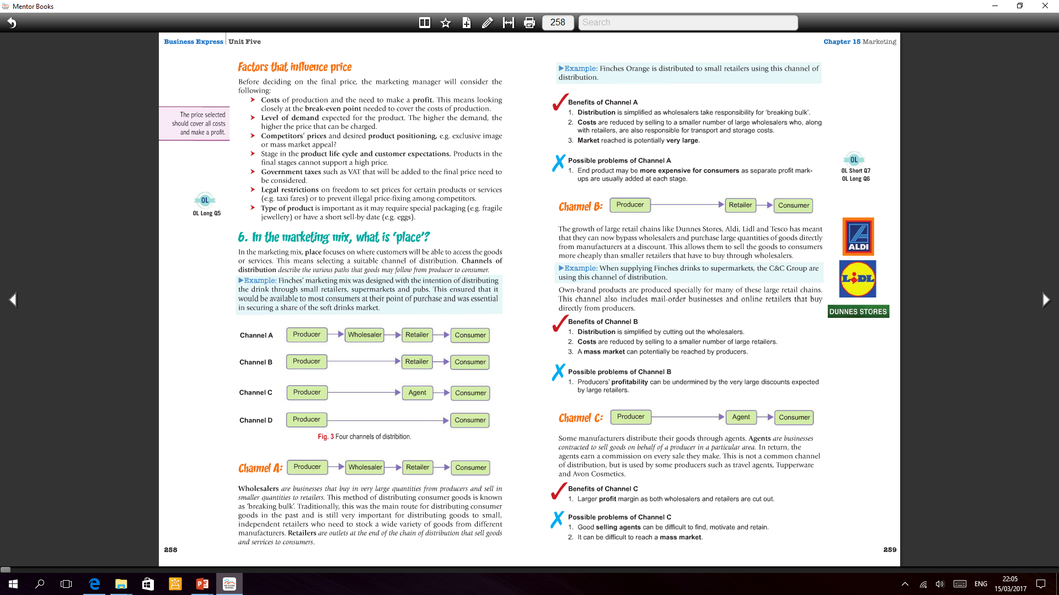


‘Place’ in the marketing mix, place focus on where customers will be able to access goods or services. This means selecting a suitable channel of distribution. Channels of distribution describe the various paths that goods may follow from producer to consumer.
Wholesalers are businesses that buy in very large quantities from producers and sell in smaller quantities to retailers
Agents are businesses contracted to sell goods on behalf of a producer in a particular area
A
1. Distribution is simplified as wholesalers take responsibility for ‘breaking bulk’
2. Costs are reduced by selling to a small number of large wholesalers who, along with retailers, are also responsible for transport and storage costs
3. Market reached is potentially very large
1. End product may be more expensive for customers as separate profit mark-ups are usually added at each stage
C
1. Larger profit margin as both wholesalers and retailers are cut out
1. Good selling agents can be difficult to find, motivate and retain
2. It can be difficult to reach a mass market
D
1. Profit is maximised for producers as there is no ‘middlemen’
2. Valuable feedback can be obtained by producers from consumers
1. All the responsibility for sales lies with the producers, not all of whom may have the marketing skills or time required
B
Retailers are outlets at the end of the chain of distribution that sell goods and services to consumers
Distribution is simplified by cutting out the wholesalers
Costs are reduced by selling to a small number of large retailers
A mass market can potentially be reached by producers
1. Producers profitability can be undermined by the very large discounts expected by large retailers

Slide 15
‘Place’ in the marketing mix, place focus on where customers will be able to access goods or services. This means selecting a suitable channel of distribution. Channels of distribution describe the various paths that goods may follow from producer to consumer.
Wholesalers are businesses that buy in very large quantities from producers and sell in smaller quantities to retailers
Agents are businesses contracted to sell goods on behalf of a producer in a particular area
A
1. Distribution is simplified as wholesalers take responsibility for ‘breaking bulk’
2. Costs are reduced by selling to a small number of large wholesalers who, along with retailers, are also responsible for transport and storage costs
3. Market reached is potentially very large
1. End product may be more expensive for customers as separate profit mark-ups are usually added at each stage
C
1. Larger profit margin as both wholesalers and retailers are cut out
1. Good selling agents can be difficult to find, motivate and retain
2. It can be difficult to reach a mass market
D
1. Profit is maximised for producers as there is no ‘middlemen’
2. Valuable feedback can be obtained by producers from consumers
1. All the responsibility for sales lies with the producers, not all of whom may have the marketing skills or time required
B
Retailers are outlets at the end of the chain of distribution that sell goods and services to consumers
Distribution is simplified by cutting out the wholesalers
Costs are reduced by selling to a small number of large retailers
A mass market can potentially be reached by producers
1. Producers profitability can be undermined by the very large discounts expected by large retailers

Slide 16
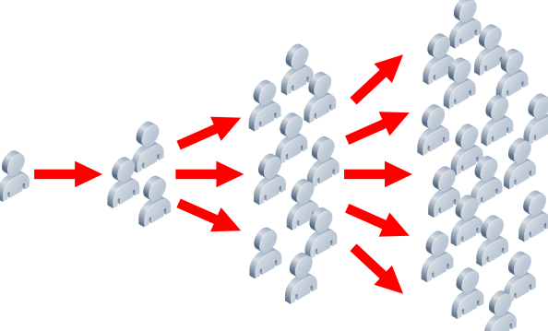
Target market – will the chosen channel reach it quickly?
Product image – how will the channel of distribution affect the desired brand image?
What are the factors that will influence which distribution channel you choose?
How easy will it be to transport supplies through this channel?
Special conditions e.g. exclusivity
Impact on cashflow – COD or credit terms
Cost – the more stages the higher the cost

Slide 17

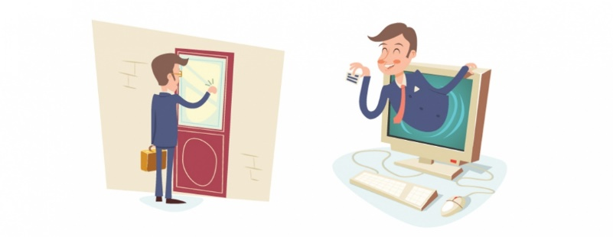
‘Promotion’ refers to all the efforts (excluding price) made by the seller to communicate and influence the target market to buy a product. Promotion is often used when: 1. a new product is being introduced to the market; 2. An existing product is at maturity, saturation or decline and sales may need to be boosted.
Refers to specific incentives offered to customers to attract their attention, increase sales and encourage customer loyalty. E.g. money off coupons, loyalty cards, free samples.
Sales Promotion
Advertising
Promotion
Personal selling refers to contacting existing and potential customers to attract their attention, increase sales and encourage customer loyalty.
Direct mail involves sending promotional messages directly to target customers, most commonly by post, door-to-door leafleting or e-mail.
Direct Selling
Public Relations & Sponsorship
Telemarketing means communicating with customers by telephone to generate sales and deal with customer queries and complaints.

Slide 18

What would influence which method you choose?
Promotion
Advertising media refers to the communication channels available to a business for its advertising
Point of sale advertising
Uses promotional displays at the place of purchase
Advertising
consists of messages designed to inform, persuade, or remind people to buy a product or service
Internet & social media
Billboard & poster advertising
Television & cinema advertising
Newspaper advertising
Magazine advertising
Radio advertising

Slide 19
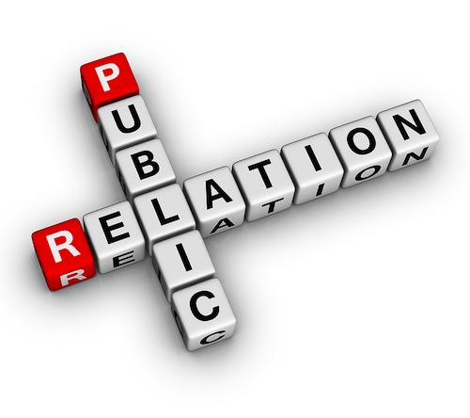
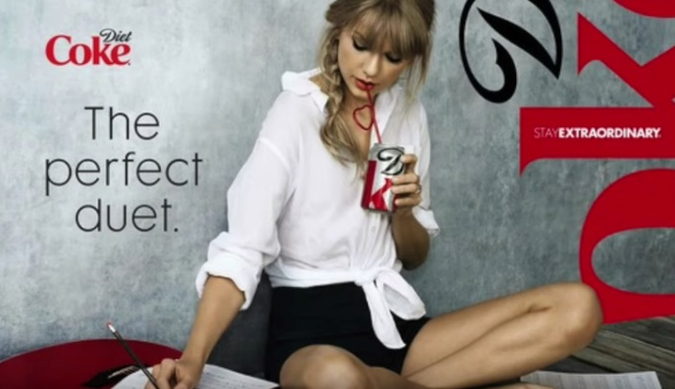
PR tries to protect and enhance the reputation of a business to boost sales. Some companies employ their own public relations officer (PRO) while others hire PR agencies to provide this service.
Sometimes, PR can mean defending the reputation of the business from criticism in time of crisis. A business does this by trying to put across the firm’s side of a tory to the public.
Promotion
PR methods
Sponsorship is a type of PR where a company puts money towards the cost of a sporting or charitable cause.
Contacting the press e.g. a product launch
Celebrity endorsement
All contact with the public is designed to create a good public impression. E.g. handling complaints etc.
Public Relations & Sponsorship
Means communicating with the media using news stories to create good publicity for a firm or its products or to respond to negative publicity.

Slide 20

Putting together a promotional campaign…
Plan
Identify the target audience
Implement
Businesses should also be prepared to react quickly to any negative feedback or controversy that the campaign might produce in order to protect the firm’s reputation and the image of a brand.
Evaluate
Compare the results of the campaign with the original objectives and identify the reasons for any unexpected success or failure.
Set a budget.
Create a promotional message. Focus on the USP.
Choose an appropriate medium to ensure the promotional message reaches the target audience as cos-effectively as possible.
Put the promotional campaign plan into action and ensure there is sufficient stock and sales staff to deal with the anticipated increased demand.

Slide 21
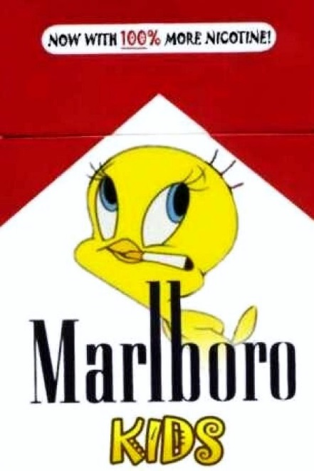
Competition & Consumer Protection Commission can prosecute business which make legally false or misleading claims. It is also responsible for enforcing the ban on advertising products such as cigarettes.
Consumer Protection Act 2007
Illegal for advertisements and other marketing promotions in Ireland to make obviously false statements.
What is the role of ethics in marketing promotion?
Advertising Standards Authority of Ireland (ASAI) a body set up and financed by the advertising industry in Ireland to ensure that advertisements are socially acceptable.
The operate a voluntary code of contact whereby advertisements are requested to be ‘legal, decent, honest and truthful. However, it only has the power to recommend that it is removed it cannot stop the advertisement.

