Slide 1

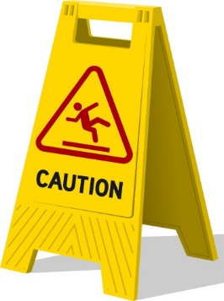



6. Work experience
7. Health & safety in the workplace…
Why is it important
Did you have to comply by any?
Adv
Dis-adv
1. WWW (what went well)
Overall, my experience…
2. EBI (even better if…)
5. Communication skills – what are they?
Did you develop yours?
4. Work shadowing – what is it?/ did you experience it?
3. What did you learn?/gain from it?
Adv
Dis-adv

